Slide 1
BANKS
Prepared by:

Slide 2
Halyk Bank (KASE: HSBK) is the backbone universal commercial bank of the country. As of January 2018, it takes the 1st place in equity among Kazakhstan banks.

Slide 3
Included in the group “Halyk” engaged in banking, insurance, brokerage and leasing activities in Kazakhstan, Kyrgyzstan, Russia and Georgia. The full company name in the Kazakh language is “Kazakhstan Halyk Bank” АҚ, in Russian - Halyk Bank of Kazakhstan JSC. Often in Russian-language newspapers it is called “Halyk Bank” by analogy with the short English-language brand “Halyk Bank”. The central office is located in Almaty.

Slide 4
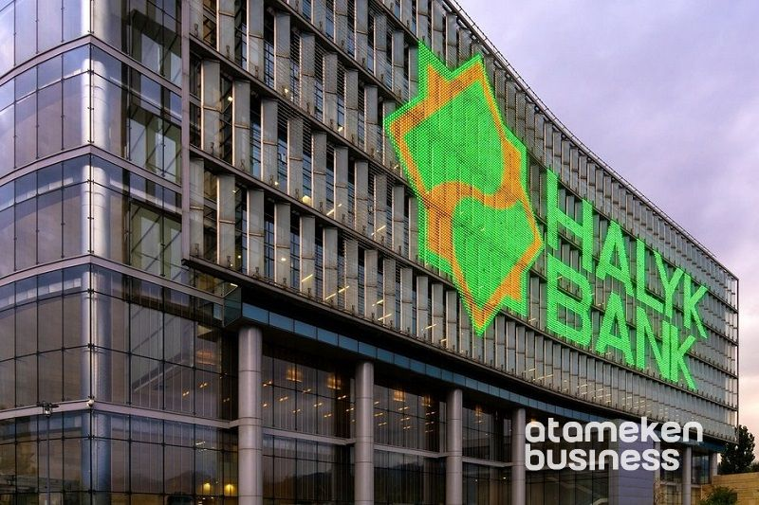
Joint stock company Halyk Bank of Kazakhstan was founded on the basis of the reorganized Savings Bank of the Republic of Kazakhstan. He is an agent of the Government of the Republic of Kazakhstan for the payment of pensions and benefits through its branch network.

Slide 5
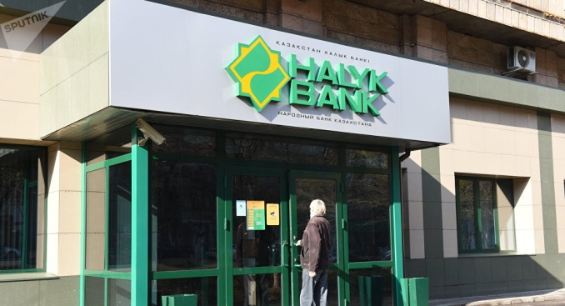
On July 28, 2018, Kazkommertsbank was merged with the Halyk Bank of Kazakhstan. On August 3, 2018, the Fitch Ratings international rating agency revised the outlook on issuer's long-term issuer default (IDR) ratings of Halyk Bank from “stable” to “positive” and confirmed the IDR at BB

Slide 6
As of December 31, 2015, the major shareholder of JSC Halyk Bank of Kazakhstan is JSC Holding Group ALMEX, with 73.4% ownership interest in the bank's shares. Holding Group ALMEX JSC on a parity basis is controlled by Timur Kulibayev and his wife Dinara Kulibayeva, the son-in-law and daughter of the President of Kazakhstan Nursultan Nazarbayev

Slide 7
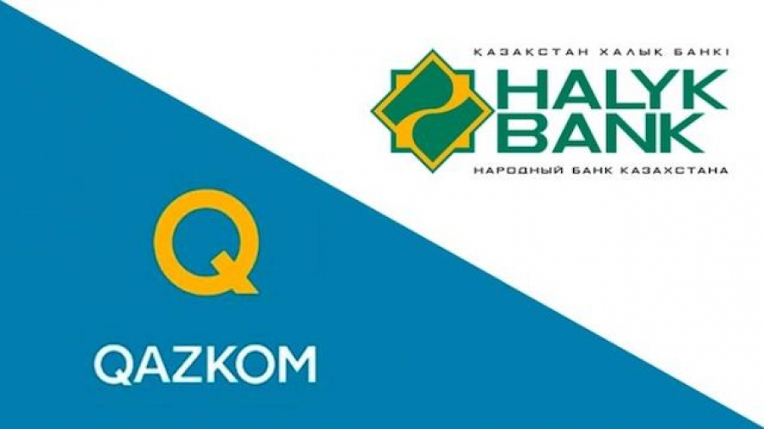
Halyk Bank of Kazakhstan JSC and its subsidiaries (jointly the Halyk Group) are today an active, dynamically developing financial group, a notable player in all major financial services markets in the Republic of Kazakhstan.

Slide 8
The group has done a lot over the past years as part of the implementation of the Corporate Strategy for 2013-2015. - the financial situation has been significantly strengthened, the business has become more technological and convenient for customers, and the basis for stable long-term growth has been created.

Slide 9
The mission of the Group is still to provide services in Kazakhstan and a number of other countries in all segments of the financial market (banking, insurance, securities, leasing), at the level of international standards, thereby ensuring the safety, efficient placement and increase of clients 'and shareholders' funds.

Slide 10
Halyk Bank of Kazakhstan JSC is the largest universal commercial bank of the Republic of Kazakhstan, which has been successfully operating for more than 90 years [source not specified 699 days], one of the most reliable and diversified financial institutions in Kazakhstan. Halyk Bank of Kazakhstan JSC was founded on the basis of the reorganized Savings Bank of the Republic of Kazakhstan and for a number of years was an agent of the Government of the Republic of Kazakhstan for the payment of pensions and benefits.

Slide 11
The privatization of the People's Bank, conducted in 2001, allowed the business to be restructured in order to be able to provide its customers with the widest possible range of quality services. The Bank issues cards of payment systems Visa International, MasterCard International, China Union Pay and remains the unchanged leader in the Kazakhstan market of payment cards.

Slide 12
conclusion
The total number of Bank cards in circulation exceeded 3.9 million units, which is about 40% of payment card users in Kazakhstan. The license to conduct banking and other operations and activities in the securities market No. 10 dated August 6, 2008, issued by the Agency of the Republic of Kazakhstan regulation and supervision of the financial market and financial organizations.

Slide 13
Thanks for attention!

